Slide 1






Jordan Radkov
Cloud Solution Architect

Slide 2
Series Agenda
1 | Determine Workload Requirements (10-15%)
2 | Design for Identity and Security (20-25%)
3 | Design a Data Platform Solution (15-20%)
4 | Design a Business Continuity Strategy (15-20%)
5 | Design for Deployment, Migration, and Integration (10-15%)
6 | Design an Infrastructure Strategy (15-20%)

Slide 3
Series Agenda
1 | Determine Workload Requirements (10-15%)
2 | Design for Identity and Security (20-25%)
3 | Design a Data Platform Solution (15-20%)
4 | Design a Business Continuity Strategy (15-20%)
5 | Design for Deployment, Migration, and Integration (10-15%)
6 | Design an Infrastructure Strategy (15-20%)

Slide 4

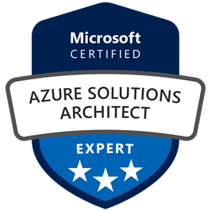

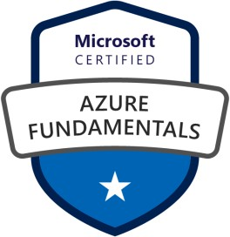



Jordan Radkov
Cloud Solution Architect based in the Munich
10+years in the industry in infrastructure administration , automation and now cloud
Constant learner - Ancora Imparo

Slide 5
Objectives
Design Deployments
May include but not limited to: Design a compute, container, data platform, messaging solution, storage, and web app and service deployment strategy
Design Migrations
May include but not limited to: Recommend a migration strategy; design data import/export strategies during migration; determine the appropriate application migration, data transfer, and network connectivity method; determine migration scope, including redundant, related, trivial, and outdated data; determine application and data compatibility
Design an API Integration Strategy
May include but not limited to: Design an API gateway strategy; determine policies for internal and external consumption of APIs; recommend a hosting structure for API management

Slide 6
Design Deployments

Slide 7


Slide 8

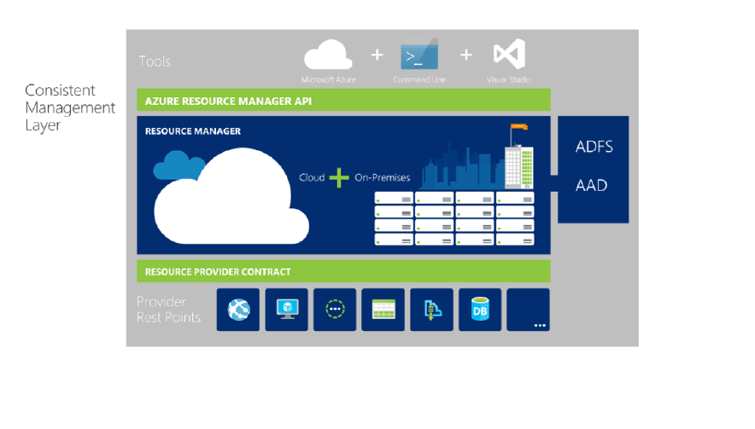

Slide 9



Slide 10






Slide 11


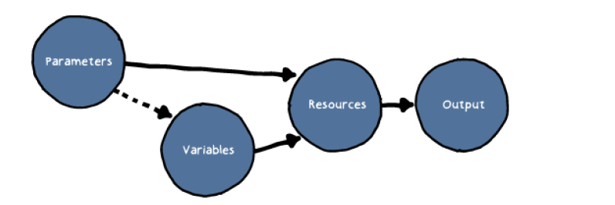






Slide 12


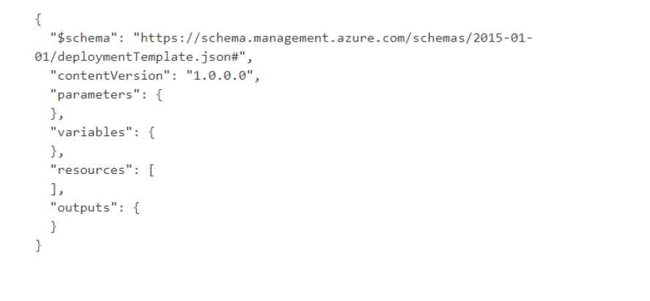






Slide 13


Slide 14






Slide 15


Slide 16



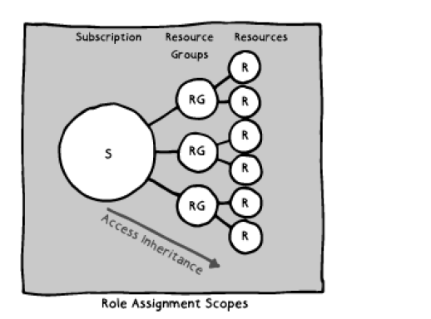



Slide 17

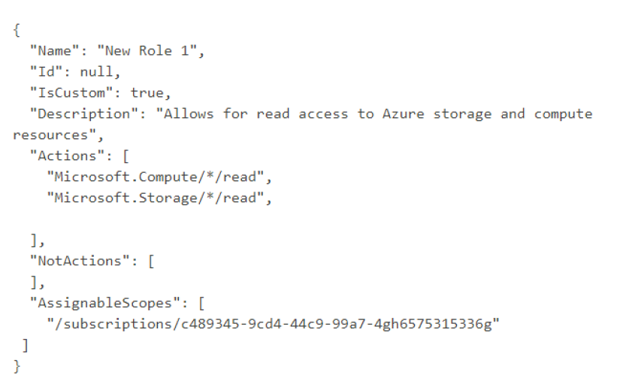









Slide 18


Slide 19



Slide 20








Slide 21



Slide 22



Slide 23


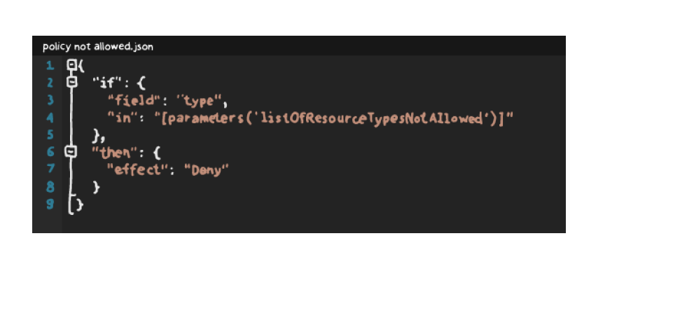












Slide 24



Slide 25


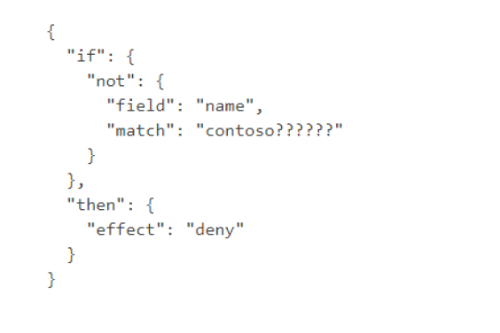

Slide 26


Slide 27


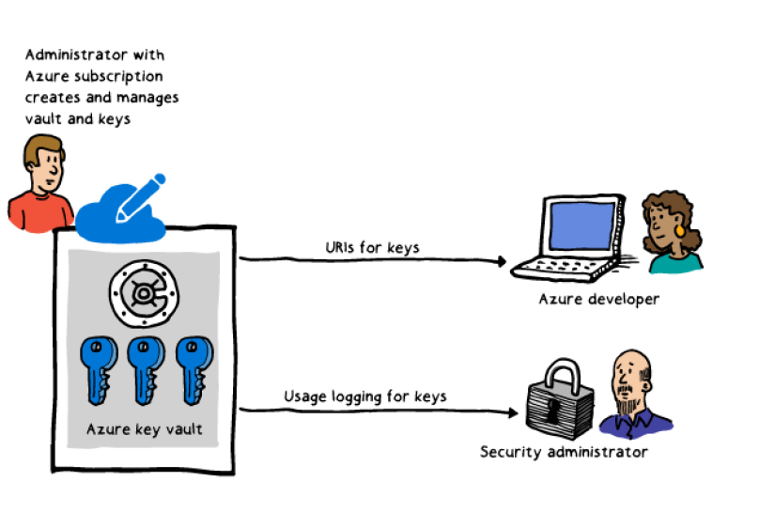







Slide 28



Slide 29


Slide 30






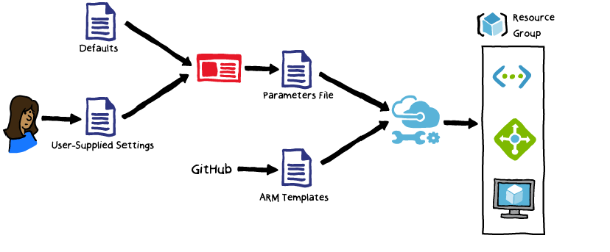



Slide 31
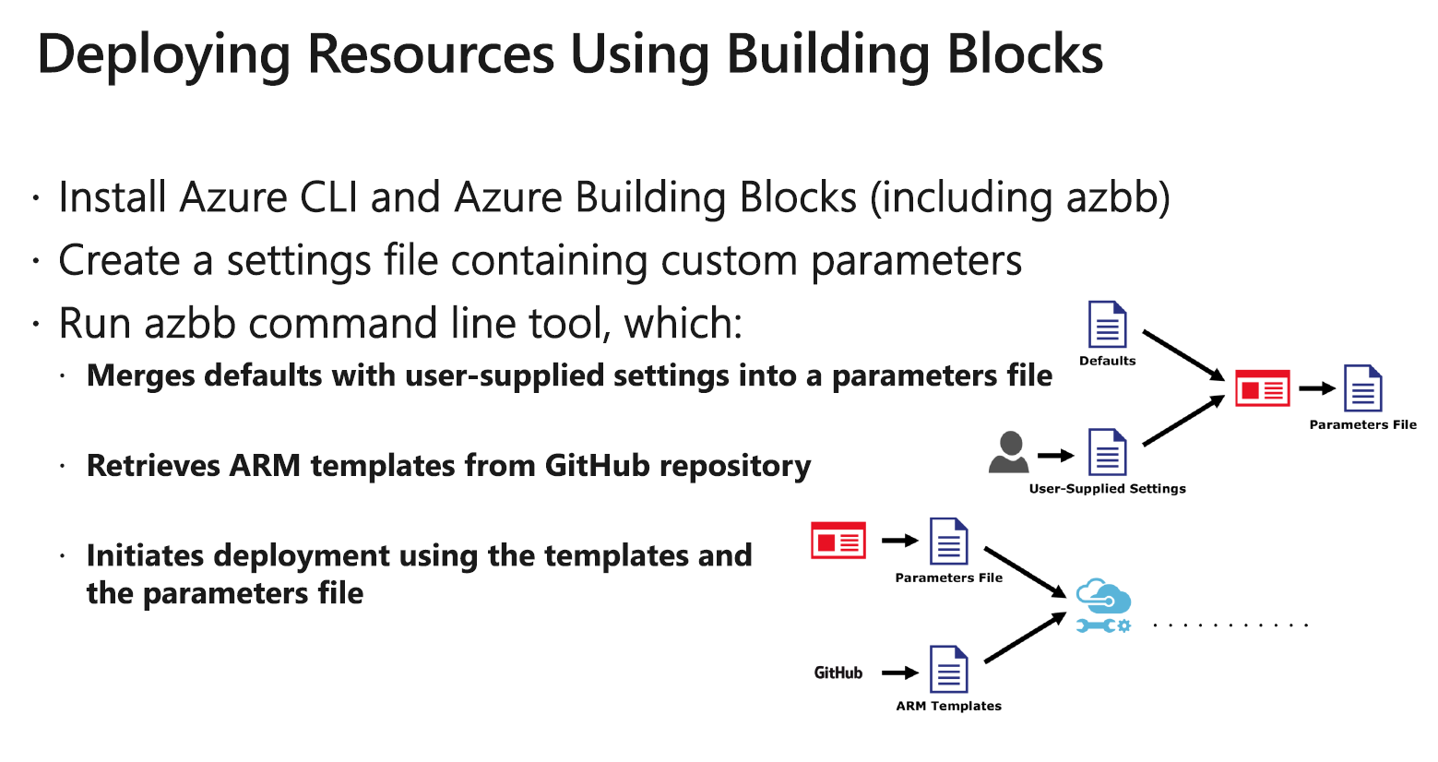





Slide 32




Slide 33
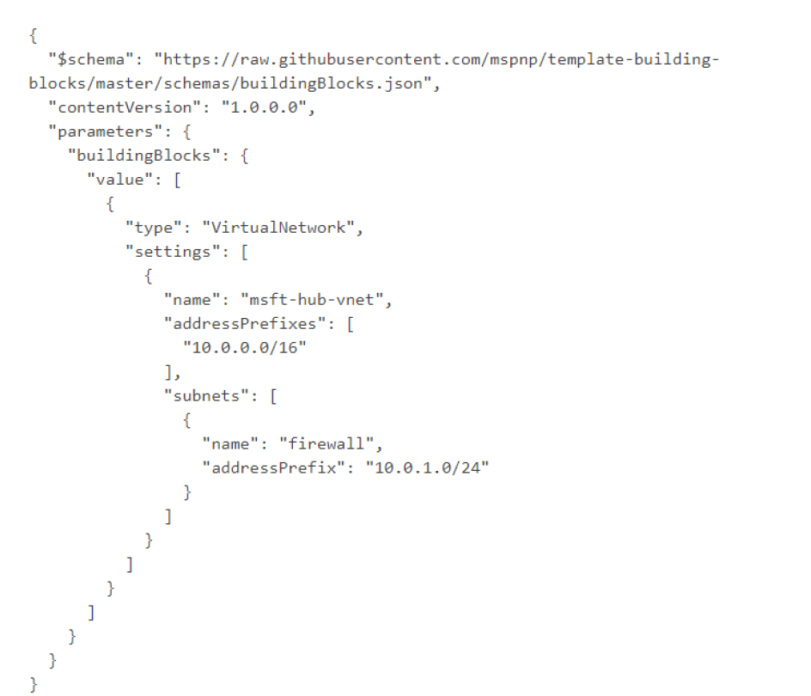






Slide 34










Slide 35
Design Migrations

Slide 36


Refactor
Rehost
Rearchitect
Rebuild
Description
Redeploy as-is to cloud
Minimally alter to take better advantage of cloud
Materially alter/decompose application to services
New code written with cloud native approach
Drivers
Reduce Capex
Free up datacenter space
Quick cloud ROI
Faster, shorter, updates
Code portability
Greater cloud efficiency
(resources, speed, cost)
App scale and agility
Easier adoption of new cloud capabilities
Mix technology stacks
Accelerate innovation
Build apps faster
Reduce operational cost
Technologies
IaaS
Containers PaaS
PaaS Serverless Microservices

Slide 37






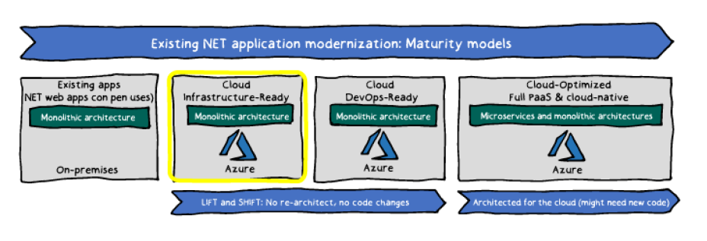


Slide 38







Slide 39
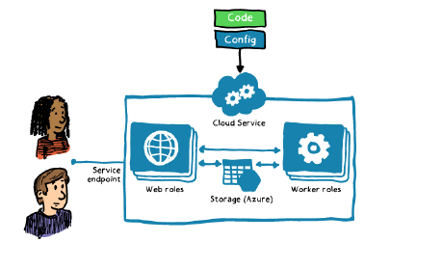
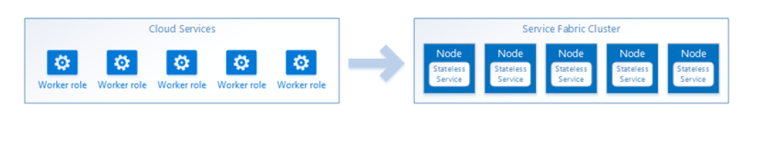

Slide 40


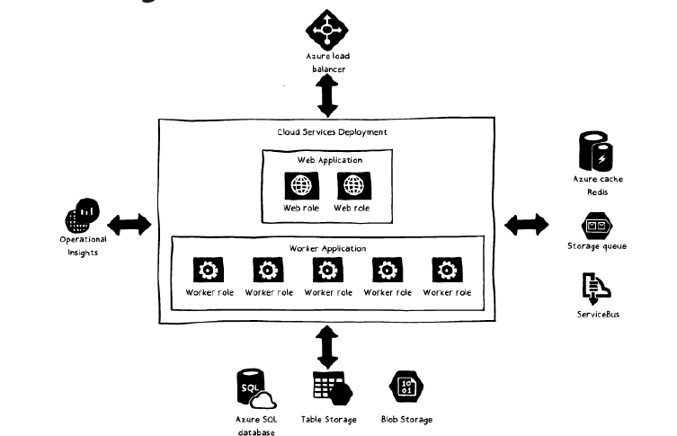

Slide 41
Design an API Integration Strategy

Slide 42







Slide 43



Slide 44




Slide 45





Slide 46







Slide 47

Questions?

